Slide 1

Green Pace
Security Policy Presentation
Developer: John Lopes
CS 405
Dr. Tony Farley
Southern New Hampshire University August 25, 2024

Slide 2

OVERVIEW: DEFENSE IN DEPTH
Defense-in-Depth is a layered security approach that involves implementing multiple protective measures to create a robust defense against potential threats. Each layer addresses different aspects of security, ensuring that even if one layer is compromised, others will continue to provide protection.
The Green Pace Security Policy integrates with the Defense-in-Depth strategy by providing specific guidelines for securing each layer of our systems. From coding standards that prevent common vulnerabilities to encryption policies that protect data in transit and at rest, the policy ensures that every aspect of our development process is fortified against threats.

Slide 3
THREATS MATRIX
Input validation issues are common and can often be exploited, making them a likely threat.
SQL injection is a critical vulnerability that can lead to significant data breaches, making it a high-priority threat.
While important, improper error handling is less likely to be exploited compared to other more critical vulnerabilities, so it may be classified as a lower priority.
Storing sensitive data without proper encryption, increasing the risk of data breaches. If proper encryption policies are in place and enforced, the likelihood of insecure data storage can be minimized, making it an unlikely threat.
Likely Unvalidated Input | Priority SQL Injection
Low priority Improper Error Handling | Unlikely Insecure Data Storage:

Slide 4
10 PRINCIPLES
Validate Input Data
STD-001-CPP
STD-002-CPP
STD-004-CPP
Heed Compiler Warnings
STD-003-CPP
STD-010-CPP
Architect and Design for Security Policies
STD-009-CPP
Keep It Simple
STD-008-CPP
Default Deny
STD-005-CPP
Adhere to the Principle of Least Privilege
STD-005-CPP
Sanitize Data Sent to Other Systems
STD-004-CPP
STD-010-CPP
Practice Defense in Depth
STD-001-CPP
STD-002-CPP
STD-004-CPP
Use Effective Quality Assurance Techniques
STD-004-CPP
STD-010-CPP
Adopt a Secure Coding Standard
STD-004-CPP
STD-006-CLG

Slide 5
CODING STANDARDS
Coding Standard | Severity | Likelihood | Remediation Cost | Priority | Level
STD-001-CPP | High | Likely | High | P2 | L2
STD-002-CPP | High | Likely | High | P9 | L2
STD-003-CPP | High | Likely | Medium | P18 | L1
STD-004-CPP | High | Likely | Medium | P18 | L1
STD-005-CPP | High | Likely | Medium | P18 | L1
STD-006-CPP | Low | Unlikely | High | P1 | L3
STD-007-CPP | Low | Likely | Low | P9 | L2
STD-008-CPP | Low | Likely | Medium | P6 | L2
STD-009-CPP | High | Medium | Medium | P18 | L2
STD-010-CPP | Medium | Probable | Medium | P8 | L2

Slide 6
ENCRYPTION POLICIES
Encryption at Rest -Protects stored data from unauthorized access by encrypting it on storage media, securing it against physical theft or unauthorized access. Ensures data confidentiality and regulatory compliance.
Encryption in Flight -Secures data during transmission across networks, preventing interception and tampering. Utilizes secure protocols and Public Key Infrastructure (PKI) for end-to-end encryption.
Encryption in Use -Protects data while it’s being processed or accessed, ensuring confidentiality and integrity through identity management and conditional access controls.

Slide 7
TRIPLE-A POLICIES
Authentication is the process of verifying the identity of users before granting access to the system. This policy mandates the use of secure authentication methods to ensure that only authorized users can access sensitive data and resources. The policy requires multi-factor authentication (MFA) to strengthen security. It supports the use of secure protocols for credential management and authentication services, such as AWS or local databases, ensuring robust identity verification.
Authorization defines what resources and operations a verified user can access within the system. This policy ensures that users have appropriate permissions based on their roles and responsibilities, preventing unauthorized access to sensitive data. Role-based access control (RBAC) or attribute-based access control (ABAC) is enforced to manage user permissions effectively. The policy also requires regular reviews and updates of user roles to reflect changes in organizational needs and job functions.
Accounting involves monitoring and recording user activities and system operations. This policy is crucial for ensuring compliance, detecting anomalies, and maintaining system integrity. The policy includes tracking of user logins, resource usage, and any changes made to the database or system. It ensures that all actions are recorded for auditing purposes, helping in the detection of unauthorized activities and supporting forensic investigations.

Slide 8
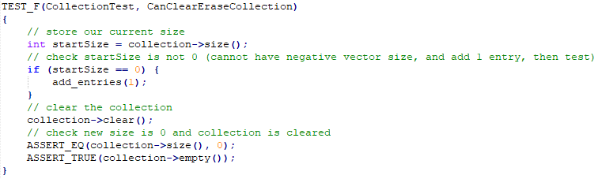
Unit Testing: CanClearEraseCollection

Slide 9
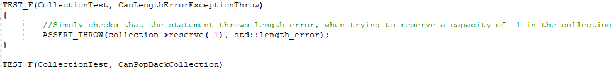
Unit Testing: CanLengthErrorExceptionThrow

Slide 10
Unit Testing: CanOutOfRangeExceptionThrow

Slide 11
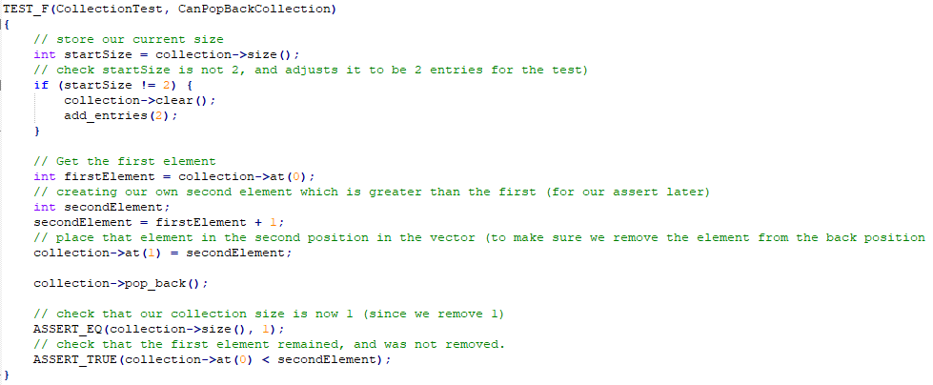
Unit Testing: CanPopBackCollection

Slide 12

AUTOMATION SUMMARY

Slide 13
TOOLS
DevSecOps involves integrating security considerations into the application and infrastructure design process from the very beginning.
The automation tools are;
Parasoft C/C++test – Utilized in the design and verification/testing phase during pre-production, and in the transition, health check, maintenance, and stabilization phases during post-production.
LoadNinja – Applied in the pre-production verification and testing phase for stress testing, and in the post-production maintenance and stabilization phase.
Logentries – Employed in the post-production monitoring and detection phase to automate log management.
Intruder – Used in the post-production transition and health check phase to conduct penetration testing.

Slide 14
RISKS AND BENEFITS
Problems -The key problems include the risk of harm to data, potential loss of customer trust, significant financial costs, and the possibility of multiple future attacks if no immediate action is taken. Waiting could exacerbate these issues, leading to more severe consequences.
Solutions -Taking early action by implementing robust security measures can mitigate potential damage, prevent threats, and create a structured and consistent security framework. This proactive approach can also reduce the overhead associated with testing and other reactive measures.
Risks of Acting Now -Acting now might involve upfront costs and resource allocation, which could strain current operations. There is also the risk that rapid changes could introduce new vulnerabilities if not carefully managed.
Risks of Waiting -Waiting increases the likelihood of data breaches, erosion of customer trust, escalating financial losses, and greater future damages due to multiple attacks. The longer the delay, the higher the risk of encountering these negative outcomes.
Strategy Gaps -The strategy may lack a comprehensive approach to ensuring ongoing security vigilance and might not account for evolving threats. Without continuous monitoring and adaptation, the strategy could become outdated and ineffective.
Steps to Take -Immediate Implementation of Security Measures: Start by addressing known vulnerabilities and strengthening defenses.
Ongoing Monitoring -Establish continuous monitoring and regular updates to adapt to new threats.
Customer Communication -Ensure transparent communication with customers about security measures to maintain trust.
Cost-Benefit Analysis -Conduct an analysis to weigh the costs of immediate action against the potential long-term financial and reputational damage of waiting.

Slide 15
RECOMMENDATIONS
Respond Phase of Post-Production -The policy currently lacks a defined action plan for the respond phase in post-production. While identification of incidents is addressed, there are no clear guidelines or procedures for how to respond to security breaches or other incidents, leaving the organization vulnerable in the event of an attack.
Build Phase of Pre-Production -In the DevSecOps pipeline, the build phase is critical for selecting from trusted repositories. However, this aspect has not been fully decided or implemented, creating a potential vulnerability. The lack of a decision on this crucial step could lead to the use of insecure tools or repositories, undermining the entire security process.
Enforcement Policies -There is a noticeable gap in the enforcement of security policies across various phases. The policy relies heavily on tool automation but does not provide clear standards or guidelines on how enforcement will be carried out. There is also no specification on the expertise required to ensure policies are followed correctly and consistently.
Lack of Regular Review and Updates -While the policy is a solid foundation, it needs to be subject to regular reviews and updates as gaps are identified. Without this, the policy may quickly become outdated, leaving the organization exposed to new and evolving threats.
External Validation -The policy does not include provisions for annual checks by an external source, such as a white hat security firm. These external assessments are crucial for providing real-world testing of security measures and identifying potential vulnerabilities that may not be apparent through internal reviews.
Proactive Policy Application -Early application and integration of security policies into the development process are not emphasized. Ensuring that security is a consistent priority from the outset would help to maintain a strong security posture throughout the development lifecycle.

Slide 16
CONCLUSIONS
Adopting best practices and coding standards;
Keep it Simple -Simplify code to minimize the risk of errors and make it easier to maintain and secure.
Use Correct Integer Precisions -Ensure that the correct data types are used to prevent vulnerabilities such as integer overflows.
Avoid Confusing Narrow and Wide Character Strings -Properly handle character data to avoid security flaws caused by encoding issues.
Handle All Exceptions -Implement comprehensive exception handling to prevent unexpected behaviors and security vulnerabilities.
Input validation and data sanitization;
Validate Input Data -Always validate and sanitize input data to prevent injection attacks and other security issues.
Default Deny -Apply a principle of least privilege, denying access by default and only allowing what is explicitly permitted.
Sanitize Data -Cleanse all data inputs to ensure that no malicious content can be introduced into the system.
Defense in Depth;
Follow and Review Defense in Depth Strategies -Implement multiple layers of security to protect against various types of attacks, ensuring that if one layer fails, others will still protect the system.
Security Awareness and Culture;
Constant Consideration of Potential Attack Motives -Regularly assess the motives behind potential attacks to anticipate and mitigate risks.
No One is Safe Attitude -Maintain a vigilant mindset that assumes the system is always at risk, encouraging proactive security measures.

Slide 17
REFERENCES
An Effortless Vulnerability Scanner. Intruder. (n.d.). https://www.intruder.io/
Argintaru, D. (2021). Data Encryption: How to Protect Data in Transit, Data in Use and Data at Rest. Mimecast.com. https://www.mimecast.com/blog/data-in-transit-vs-motion-vs-rest/
Authentication, Authorization, Accounting and Identity Management. (2018, April 3). CCSI. https://www.ccsinet.com/blog/aaa-identity-management/
Fogg, E. (2021, May 11). What Can and Should be Automated in Software Development? ProdPerfect. https://prodperfect.com/blog/test-development/automated-software-development/#:~:text=Automating%20part%20of%20your%20application’s,quality%20of%20your%20test%20suite
Hill, M. (2021, July 16). The 15 biggest data breaches of the 21st century. CSO Online. https://www.csoonline.com/article/2130877/the-biggest-data-breaches-of-the-21st-century.html
LoadNinja. (n.d.). Create and Run Load Tests in Half the Time. https://loadninja.com/
Logentries. (n.d.). Log Management & Analysis Software Made Easy. https://logentries.com/
Parasoft. (2021, June 7). C++test - Check C++ and C Code for Compliance. https://www.parasoft.com/products/parasoft-c-ctest/
RedHat. (2021). What is DevSecOps? https://www.redhat.com/en/topics/security/devsecops/approach#:~:text=DevSecOps%20helps%20IT%20and%20security,development%20and%20infrastructure%20life%20cycle

